Slide 1
Fraud-Resistant Meal Vouchers and Real-Time Analytics for Conference Management
ConferenceCheck Mobile: Analytics, Meals and Notifications (component 4.3b)
Ndashi Bwalya Chisanga
2021470105
Final Year Project Presentation
University of Zambia
School of Natural and Applied Sciences
Department of Computing and Informatics
2026
Final Year Project • Academic Year 2026 1
Notes:
Introduce yourself and the project. This is component 4.3b of the ConferenceCheck capstone: everything that happens after check-in. Meals, session capacity, notifications, analytics and reports. Component 4.3a, check-in and offline sync, is a separate project.

Slide 2
Project Role and Responsibilities
Member | Computer No. | Primary Role / Responsibilities
Ndashi Bwalya Chisanga | 2021470105 | Sole developer of component 4.3b: requirements, Flutter app, Laravel API, database design, evaluation and documentation
Supervisor: Mr. Mofya Phiri
Sibling component
Component 4.3a (core check-in capture and offline sync engine) is a separate project. This component reads check-in data through the agreed REST API contract and uses a minimal check-in stub so it can be built and tested on its own.
Final Year Project • Academic Year 2026 2

Slide 3
Presentation Overview
Background, aim and objectives
System analysis and design
Implementation and development
Testing, results and evaluation
Discussion and limitations
Conclusion
System demonstration
Final Year Project • Academic Year 2026 3

Slide 4
Background and Context
The problem
Who it is for
Paper meal vouchers can be photographed, copied or presented twice, and nothing at the serving point can tell.
Check-in data is not shown to organisers as it happens, so catering and rooms are planned on guesswork.
Session rooms have capacity limits, but nobody is warned before one overcrowds.
Messages to attendees are one-way and unlogged.
Organisers: live dashboard, alerts, reports
Scanner staff: meal and session scanning
Attendees: their meal vouchers, pass and notifications
Caterers: fewer duplicate meals to pay for
A QR code alone prevents nothing: a photographed code works as well as the real one. Any guarantee has to come from what the server does with a scan.
Final Year Project • Academic Year 2026 4
Notes:
The key point: a QR code on its own has no anti-fraud property. The closest prior work, Masalha and Hirzallah [3], proposes a QR attendance system as a design with no measured comparison against manual registers, so there is no published figure to compare against. Do NOT say it found QR "faster and more accurate"; that was corrected.

Slide 5
Aim and Objectives
Aim: design, build and evaluate the analytics, meals, session capacity, notification and reporting component, giving organisers live insight, fraud-resistant meal redemption and auditable attendee communication.
1
Analytics dashboard
2
Single-use meal vouchers
check-in progress, rates and trends (near-real-time, 30 s poll)
QR redemption across several meal categories
3
Session capacity
4
Push notifications
attendance tracking and overcrowding alerts
with a delivery record for each recipient
5
Reports
6
Evaluation
CSV export for organisers
against the proposal's Table 3 targets and a manual baseline
7
Documentation
technical documentation and a paper
Final Year Project • Academic Year 2026 5

Slide 6
System Architecture
ConferenceCheck Mobile: Flutter app (Android)
Component 4.3a (separate project)
Check-in capture, offline sync engine
Component 4.3b (this project)
Dashboard · meal vouchers · session capacity · notification inbox · reports
REST API, Sanctum bearer tokens, JSON envelope
Standalone Laravel 13 API
47 routes · role checks per event · minimal check-in stub
PostgreSQL 18
Firebase Cloud Messaging
push to devices, best effort; the in-app inbox is the guaranteed channel
App layers: Flutter widgets → Riverpod providers → repositories → one authenticated REST client. Offline scans go to a durable queue on the device.
Final Year Project • Academic Year 2026 6

Slide 7
Database / Data Design
Relation | Purpose | Integrity constraint that matters
meal_vouchers | one voucher per attendee per meal category | unique qr_token; unique (attendee, category)
meal_redemptions | append-only record of each redemption | unique meal_voucher_id = single use; deletes restricted, not cascaded
meal_categories | Breakfast, Lunch, Supper windows | owned by the event; time-windowed
event_sessions / session_attendance | sessions and who attended | unique (session, attendee) stops double counting
attendees | attendee records, shared with 4.3a | unique ticket_code and qr_token
device_tokens / notification_recipients | push registration and per-recipient delivery | delivery auditable per user
Design decision: the anti-fraud rule lives in the schema. A second redemption of the same voucher cannot be inserted, whatever the application code does before the insert.
Final Year Project • Academic Year 2026 7

Slide 8
Technical Design: the Redemption Protocol
1
Scan
2
Lock
3
Check
4
Record
scanner submits the opaque QR token and its device id
inside a transaction, the voucher row is locked (lockForUpdate)
404 unknown token · 409 already redeemed · 422 window closed
mark redeemed and insert the redemption row
Two independent safeguards
Why the database, not the app
The row lock makes a second scan wait for the first to commit. The unique constraint refuses a second redemption row even if the lock were missing; that error is returned as the same 409.
Check-then-insert in application code lets two scans both pass the check before either writes. The experiment on slide 14 shows that race happening.
Final Year Project • Academic Year 2026 8
Notes:
IF ASKED TO WALK THROUGH scanVoucher (app/Http/Controllers/Api/MealController.php):
1. scanVoucher calls redeem() inside a try/catch for UniqueConstraintViolationException.
2. redeem() runs in DB::transaction. It selects the voucher by qr_token with lockForUpdate(), so on PostgreSQL a second scan of the same voucher waits until the first transaction ends.
3. No voucher, or a voucher from another event: 404 "Invalid meal voucher QR token."
4. Status is not unused: 409 with the status and the earlier redeemed_at.
5. Category not active, or now is outside starts_at to ends_at: 422.
6. Otherwise update the voucher to redeemed and create the meal_redemptions row with the device id. 200.
7. If the insert ever hits the unique constraint on meal_voucher_id (only possible if the lock is missing), the exception is caught OUTSIDE the transaction and turned into the same 409, never a 500.
Why order matters: the 409 check comes before the 422 checks, so an already-redeemed voucher always says "already redeemed".

Slide 9
Development Environment
Item | Used
Operating system | Windows 11; Android emulator (API 36)
Languages | Dart, PHP 8.5, Python 3.14 (evaluation scripts)
Frameworks | Flutter 3.44 with Riverpod, fl_chart, qr_flutter, mobile_scanner; Laravel 13 with Sanctum
Database | PostgreSQL 18.2
Tools | VS Code, Android SDK, PHPUnit, PHPStan level 7, Pint, flutter analyze
Version control / services | Git and GitHub; Firebase Cloud Messaging v1
Final Year Project • Academic Year 2026 9

Slide 10
System Components / Modules
Analytics dashboard
Meal vouchers
Sessions
check-ins, meal redemption rate, session occupancy; refreshes every 30 s
one voucher per attendee per category; scanner with camera or manual entry; My meals screen for attendees
door scans, capacity states (available, warning at 90%, over capacity) and organiser alerts
Notifications
Reports
Offline queue
organiser broadcasts, FCM push, per-recipient records, in-app inbox
attendance, meals, sessions and notifications as CSV, read in chunks of 1,000
scans saved on the device and replayed in order when back online
Final Year Project • Academic Year 2026 10

Slide 11
Key Implementation Details
Redemption
row lock plus unique constraint; constraint error caught outside the transaction and returned as 409, not 500
Offline replay
only a definitive business answer (404, 409, 422) settles a queued scan; anything else keeps it and every scan after it
Offline meal rule
a queued meal scan is not a redemption; the scanner says "do not serve this meal"
Notifications
recipient rows committed first, pushes sent after; a recipient is "sent" only when one of their own tokens was accepted
Access control
attendees see only their own vouchers and notifications; reports are organiser only; each rule has a 403 test
Final Year Project • Academic Year 2026 11
Notes:
IF ASKED WHY REPLAY SETTLES ONLY 404, 409 AND 422 (mobile/lib/features/sync/application/scan_sync_controller.dart):
Those three are final answers about the token itself: 404 the token does not exist, 409 it was already used (or the attendee is already in the session), 422 it cannot be redeemed now (category inactive or window closed). Sending the same scan again will always get the same answer, so keeping it would only block the queue.
Everything else is about the conditions, not the token: no connection, 401 expired login, 403, 408, 429 rate limit, 5xx server fault. A later retry can succeed, so the scan is kept.
When one scan is kept, every scan after it is kept too and the run stops, so the order the scans were made in is preserved.
This is safe because the server is idempotent: a scan that already reached the server just comes back as 409 on replay, never as a second redemption.
Tests: mobile/test/scan_replay_test.dart and scan_replay_restart_test.dart, run against a fake API, not on a device.

Slide 12
Challenges and Solutions
The first race test passed for the wrong reason
Solution
it ran on a one-request-at-a-time server, so it could not tell a safe design from a naive one
five server processes on PostgreSQL, every combination of the two safeguards, and a no-safeguard control expected to fail
Attendees could read other people's data
Solution
another attendee's voucher, the exports, redemption history, organiser notifications
role and ownership checks on each route, each with a test that expects 403 and fails on the old code
The voucher flow did not work in the app
Solution
the app showed only the check-in pass, which the meal scanner rightly rejects with 404
My meals screen showing each voucher as a QR; trial gave 200 then 409
Offline replay dropped scans
Solution
an expired login or server fault was treated as final and the scan lost
only 404, 409 and 422 settle a scan; everything else is kept, in order
Final Year Project • Academic Year 2026 12

Slide 13
Test Results
70 / 70
30 / 30
55
backend tests pass
31 are this component's
Flutter tests pass
test cases TC-01 to TC-55
in the validation document
ID | Test case | Expected | Actual | Result
TC-04 | valid meal voucher scan | 200, one redemption row | 200 | Pass
TC-05 | second scan of a redeemed voucher | 409 with earlier time | 409 | Pass
TC-06 | duplicate caught by the unique constraint | 409, not 500 | 409 | Pass
TC-24 | attendee on staff or organiser routes | 403 | 403 | Pass
TC-52 | attendee app shows the meal voucher | QR of the voucher token | decodes to MEAL-DEMO-1-3 | Pass
TC-53/54 | device trial: first scan, then repeat | 200, then 409 | 200, then 409 (x2) | Pass
Final Year Project • Academic Year 2026 13

Slide 14
Results: Double Redemption Under Parallel Load
With either safeguard
50 of 50 races gave exactly one redemption, and no response was a server error.
With neither
48 of 50 vouchers redeemed more than once, although the status check was there. The control fails, so the test can detect the race.
PostgreSQL behind five PHP server processes, five simultaneous scans per race. Source: tools/concurrency-results.json
Final Year Project • Academic Year 2026 14
Notes:
IF ASKED HOW run-concurrency-experiment.py PATCHES EACH WORKTREE:
1. For each configuration it runs "git worktree add --detach <temp dir> HEAD", so every configuration runs the same commit.
2. In that copy it edits MealController.php: for "lock off" it deletes ->lockForUpdate(); for the widened run it inserts usleep(50 ms) just before the write, in all four configurations alike. It first checks each pattern appears exactly once, and stops if the controller no longer matches.
3. "Constraint off" is not a code change: the unique constraint is dropped on a scratch database, conferencecheck_concurrency, which the script creates and drops.
4. It copies .env, gives the worktree its own copy of Composer's autoloader and links only the packages, because linking the whole vendor folder would load the main checkout's classes. It then checks by reflection that the worktree really loads its own patched controller.
5. It starts five "php -S" servers on ports 8101 to 8105 and fires the five scans of one fresh voucher at the same moment, one to each server, 50 races per configuration.
The supervisor reran it unchanged: one winner in every race with a safeguard, 49 of 50 double-redeemed with neither (ours: 48).

Slide 15
Evaluation Against the Proposal's Targets
Criterion | Target | Result | Status
Duplicate redemption | 100% refused | 100/100 sequential; 50/50 races with a safeguard | Met
Scan latency | median < 500 ms, p95 < 1 s | 145.3 ms / 261.0 ms over loopback | Met on loopback
Dashboard freshness | ≤ 30 s | 20/20 in the recorded run (poller, not the app); a rerun gave 19/20 | Not guaranteed by design
Export correctness | equal to the database | all four equal to SQL; notifications.csv was 0 vs 0 | Met, with limits
Capacity warning | before the room is full | two tests, one emulator observation, not timed | Partly met
Push delivery | ≥ 95% within 30 s | one device, about 5 s | Not measured
Manual baseline | compared with a paper line | not run | Not run
Final Year Project • Academic Year 2026 15

Slide 16
Discussion of Findings
Most important finding
A database lock or a unique constraint is what stops double redemption under parallel load. An application check alone does not, even when it is present.
Against the problem and objectives
Against existing work
Single use now holds at the serving point and in the app (one emulator trial). Organisers get live figures and overcrowding alerts. Scan latency leaves about 355 ms of the 500 ms target for venue Wi-Fi.
Masalha and Hirzallah [3] propose a QR attendance system as a design, with no measured comparison. There is no published figure to set these results beside; this work measures under parallel load with a control.
Final Year Project • Academic Year 2026 16

Slide 17
Limitations
Simulated, not live
Loopback latency
seeded 500-attendee event, scripted scans, one emulator
one machine; venue Wi-Fi not measured
Shown, not measured
No manual baseline
capacity alert timing, fleet push delivery, camera decoding
the staffed paper-line comparison was not run
4.3a integration
Deployment hardening
built against its own check-in stub, not 4.3a's API
plain HTTP in development, no login rate limit; Android only
The results are a controlled measurement on synthetic data, not a field measurement.
Final Year Project • Academic Year 2026 17

Slide 18
Conclusion
Objective | Status
1. Analytics dashboard | Built; 30 s poll, freshness not guaranteed by design
2. Single-use meal vouchers | Met at the API; in the app shown once on an emulator, manual entry
3. Session capacity and alerts | Met in function; alert timing not measured
4. Push notifications | Verified end to end on one device; fleet delivery not measured
5. Reports and CSV export | Met
6. Evaluation | Partly met: fleet push and the manual baseline not run
7. Documentation | Report and validation done; paper not yet publication-ready
Recommendations
Run a live trial at a real event
Two-phone camera trial and the manual baseline
Replace polling with a WebSocket stream
Integrate with 4.3a's own API
Harden for deployment: HTTPS, rate limits, iOS
Final Year Project • Academic Year 2026 18

Slide 19
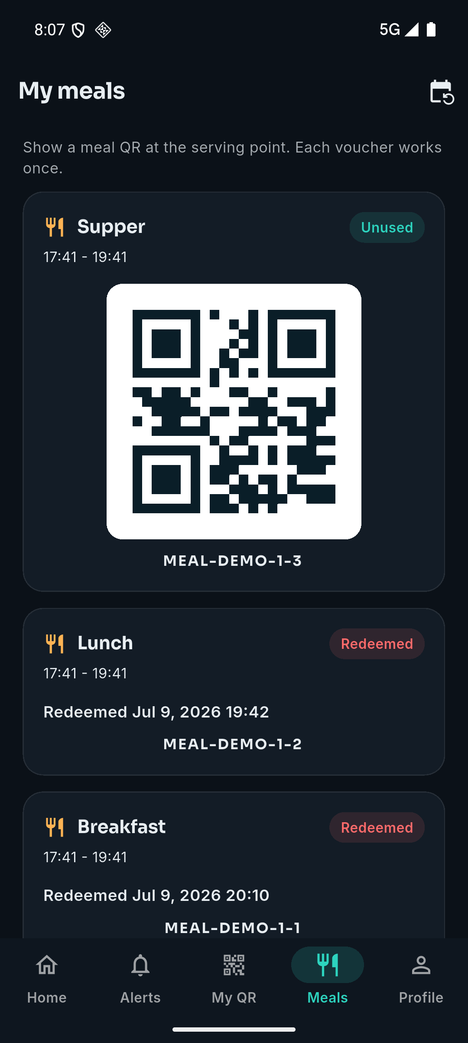
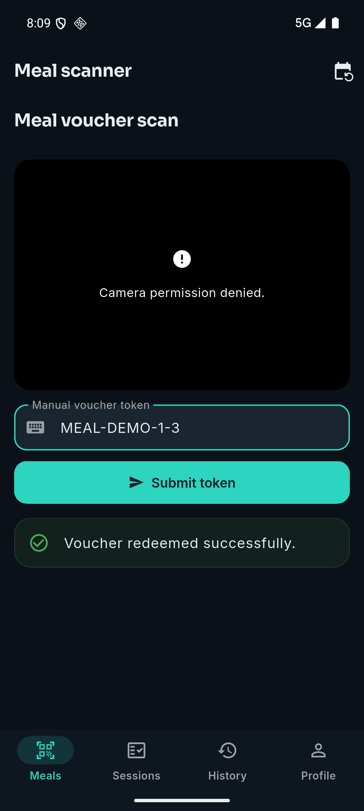
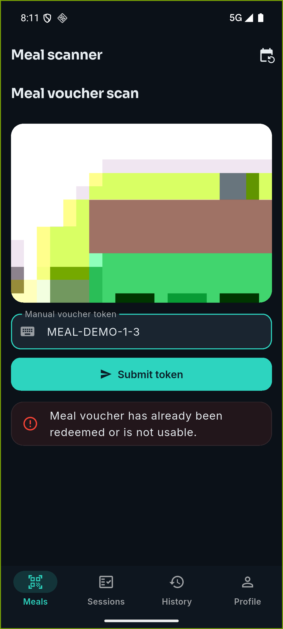
System Demonstration
1. Attendee: My meals shows the Supper voucher
2. Scanner: first scan, 200 redeemed
3. Same token again: 409 refused
Final Year Project • Academic Year 2026 19
Notes:
LIVE DEMO SCRIPT:
Before: run php artisan db:seed the same morning (the seeded meal windows close two days after seeding), start the server (serve-pgsql.bat), have both phones on the same network as the laptop.
1. Attendee phone: log in as attendee@example.com / password, open the Meals tab. Supper is Unused with a QR code.
2. Scanner phone: log in as scanner@example.com, Meal scanner, point the camera at the attendee phone. Expect "Voucher redeemed successfully." (200)
3. Scan it again: "Meal voucher has already been redeemed or is not usable." (409)
4. Optional: scan the attendee pass from My QR at the meal scanner: 404, because the pass is not a meal voucher.
5. Organiser: dashboard shows the redemption count go up within one 30 s refresh.
If the camera fails, type the token into the manual field; say so plainly.

Slide 20
Questions and Discussion
Thank you
Questions?
Final Year Project • Academic Year 2026 20

